Slide 1
LOW POWER VLSI CITCUIT DESIGN
Design and Analysis of a Low-Power 4-Bit Counter Using Clock Gating Technique
Submitted By: Karthick M
Tool Used: Vivado 2025.2
VLSI

Slide 2
Introduction
LOW POWER VLSI CIRCUIT DESIGN
Very Large Scale Integration (VLSI) technology enables the integration of millions of transistors onto a single chip. As circuit complexity increases, power consumption becomes a major concern in digital systems. Excessive power consumption leads to higher heat generation, reduced battery life, and lower system efficiency.
To overcome these challenges, low-power design techniques are widely used in modern VLSI circuits. In this project, a Clock Gating technique is implemented on a 4-bit counter to reduce dynamic power consumption by minimizing unnecessary switching activity.
2

Slide 3
Objectives
LOW POWER VLSI CIRCUIT DESIGN
1
Identify the major sources of power consumption in VLSI circuits.
2
Design a conventional 4-bit counter using Verilog HDL.
3
Apply Clock Gating as a low-power design technique.
4
Simulate the circuit using Vivado.
5
Analyze and compare power consumption of both designs.
6
Demonstrate power optimization through reduced switching activity.
3

Slide 4
Technology Used
LOW POWER VLSI CIRCUIT DESIGN
SOFTWARE
LANGUAGE
Software Tool
Hardware Description Language
Vivado 2025.2
Verilog HDL
TECHNIQUE
DESIGN
Design Technique
Design Type
4-Bit Binary Counter
Clock Gating
Simulation
Vivado Simulator
4

Slide 5
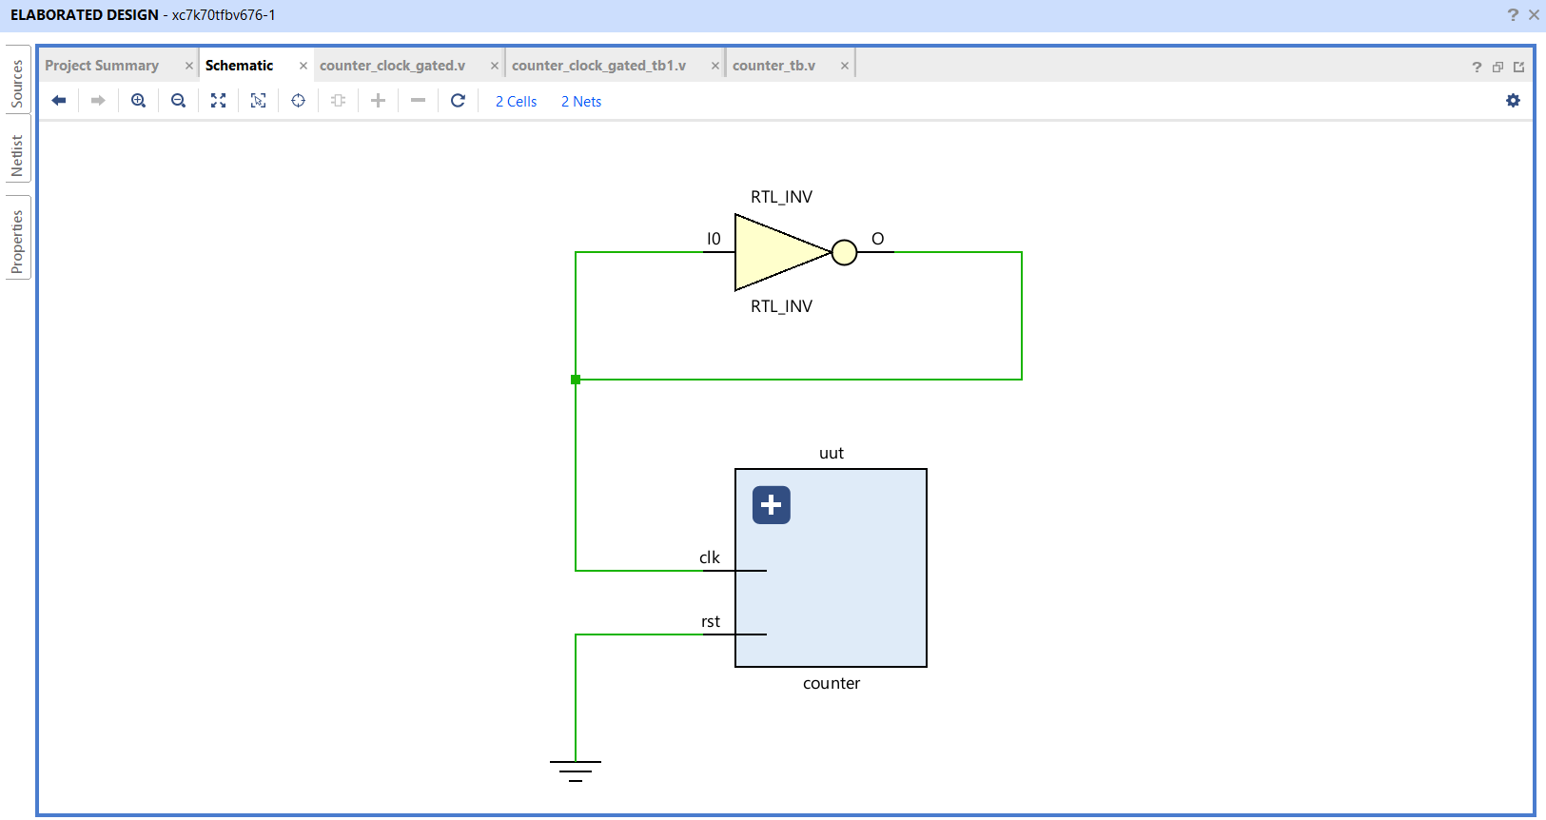
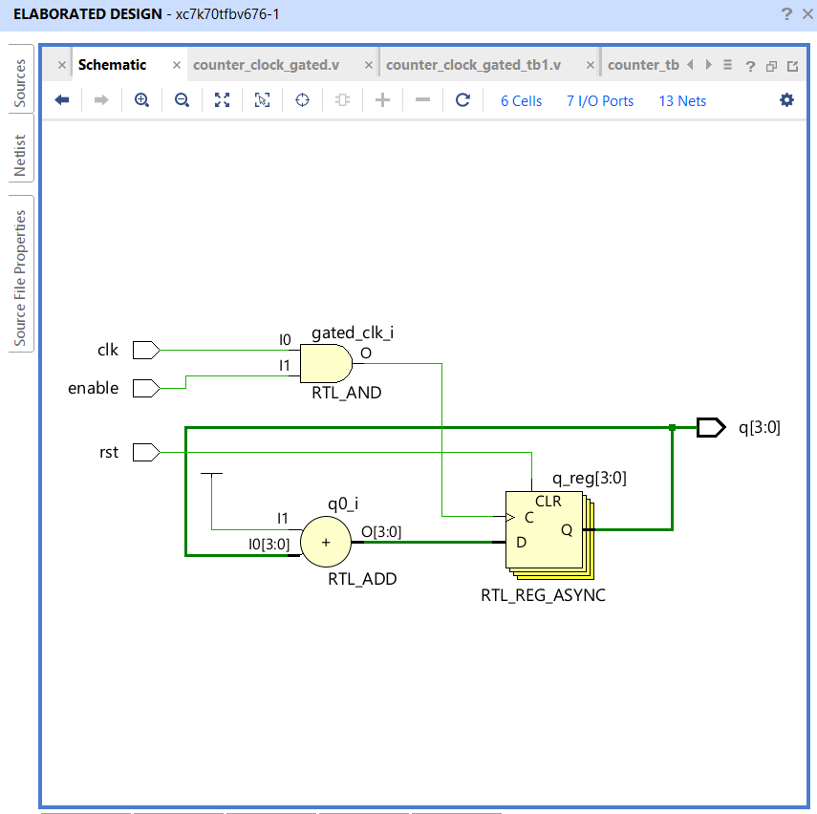
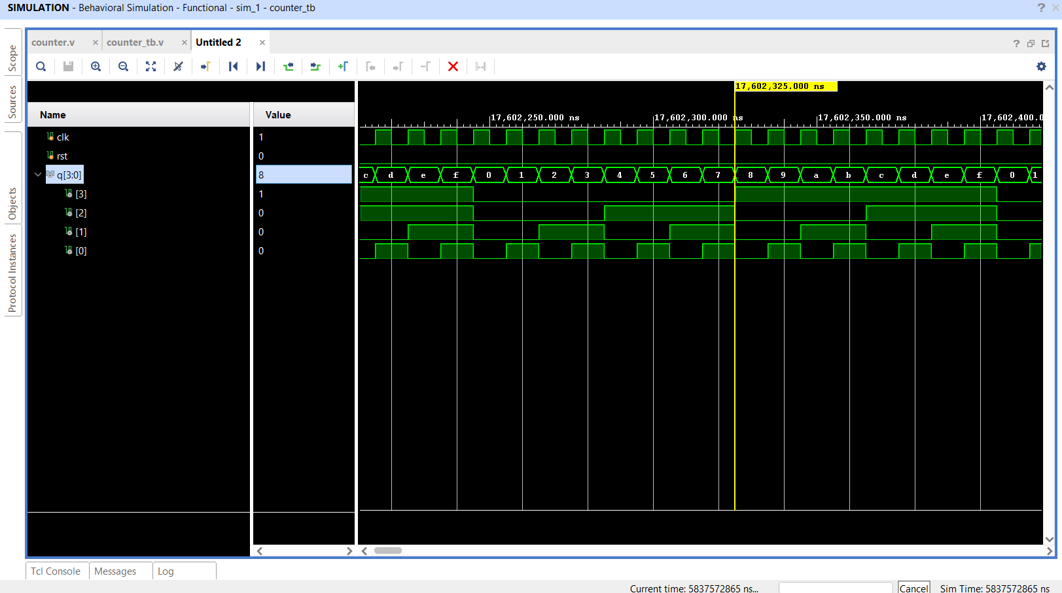
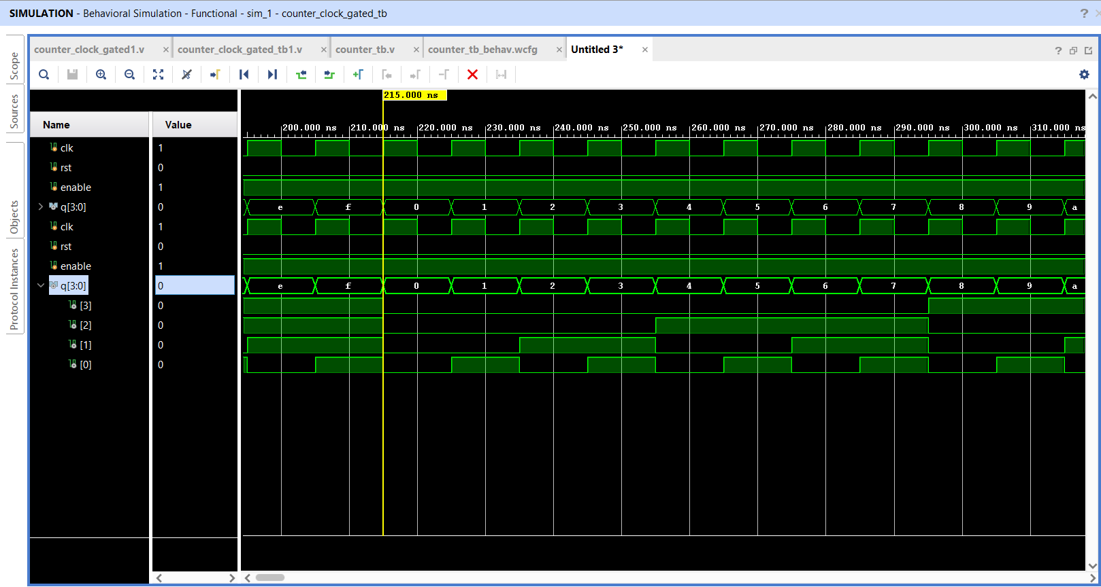
Methodology
LOW POWER VLSI CIRCUIT DESIGN
Design Flow Steps
RTL & Waveform Screenshots
Designed a conventional 4-bit binary counter
using verilog
Simulated the counter and verified its
counting operation.
Implemented Clock Gating using an
Enable signal.
RTL - Conventional Counter
RTL - Clock-Gated Counter
Designed the low-power clock-gated
counter.
Performed behavioral simulation and
verified functionality.
Generated power reports using Vivado.
Waveform - Conventional Counter
Waveform - Clock-Gated Counter
Compared power consumption between conventional and clock-gated designs.
5

Slide 6


Output / Result
LOW POWER VLSI CIRCUIT DESIGN
Table 1. Power Analysis Results Comparison
Parameter | Conventional | Clock-Gated
Dynamic Power | 3.766 W | 0.000 W
Static Power | 0.089 W | 0.079 W
Total Power | 3.855 W | 0.079 W
Power Report Screenshots
Conventional Counter Power
Clock-Gated Counter Power
Observation
The clock-gated counter significantly reduced switching activity and achieved approximately 97.95% reduction in total power consumption.
Conventional Counter
Clock-Gated Counter
Power Reduction
3.855 W
0.079 W
97.95%
6

Slide 7
Conclusion
LOW POWER VLSI CIRCUIT DESIGN
The project successfully demonstrated the implementation of a low-power VLSI design using the Clock Gating technique. A conventional 4-bit counter and a clock-gated counter were designed and simulated using Verilog HDL in Vivado. Power analysis showed a substantial reduction in dynamic power consumption, proving the effectiveness of clock gating as a low-power optimization technique. This approach can be applied to larger digital systems to improve energy efficiency and overall performance.
Clock Gating Proven Effective
Dynamic power reduced from 3.766 W to 0.000 W through controlled clock distribution.
97.95% Power Savings
Total power consumption dropped from 3.855 W to just 0.079 W.
Scalable to Larger Systems
This approach can be applied to larger digital systems to improve energy efficiency.
Summary: Clock Gating is a simple yet powerful technique for reducing dynamic power in synchronous digital circuits, making it essential for modern low-power VLSI design.
7

Slide 8
Thank You
Karthick M
Low Power VLSI Circuit Design
Tool Used - Vivado 2025.2
8

